Slide 1
Individual homework
Logic circuits – exercise 4
Write a Boolean function of 4 variables given by its table of values, simplify it and draw the logic circuits corresponding to all its simplified forms.
Cojocariu Robert
Group 912

Slide 2
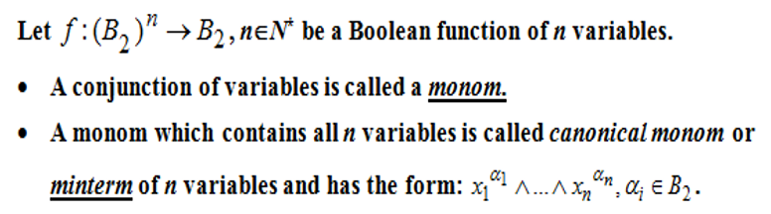
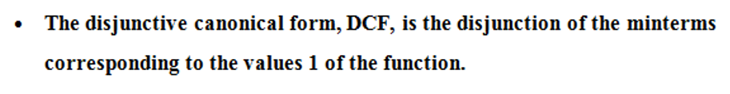
Theoretical results

Slide 3
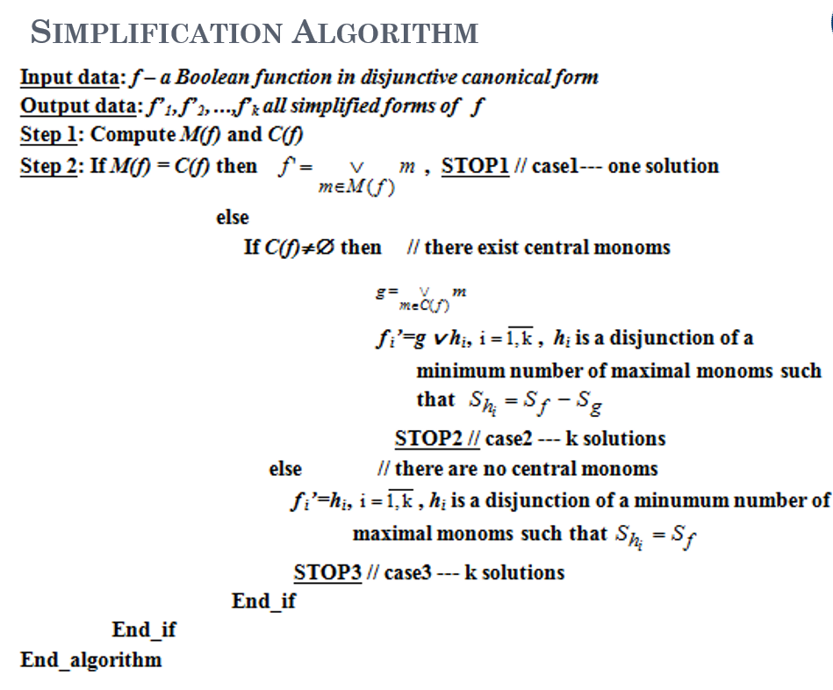
Theoretical results

Slide 4
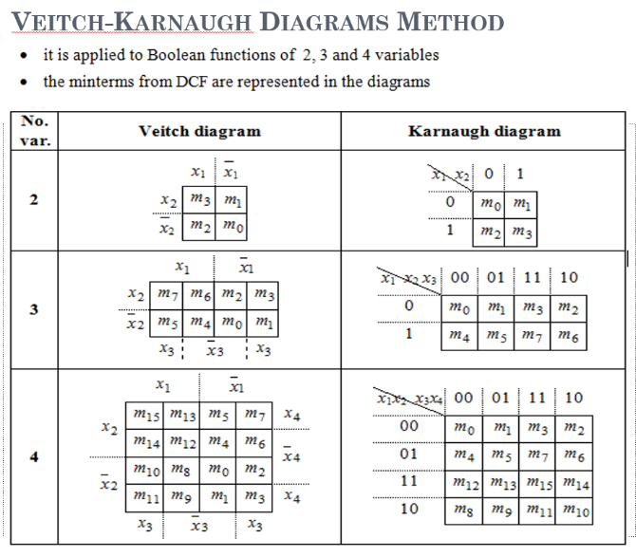
Theoretical results

Slide 5
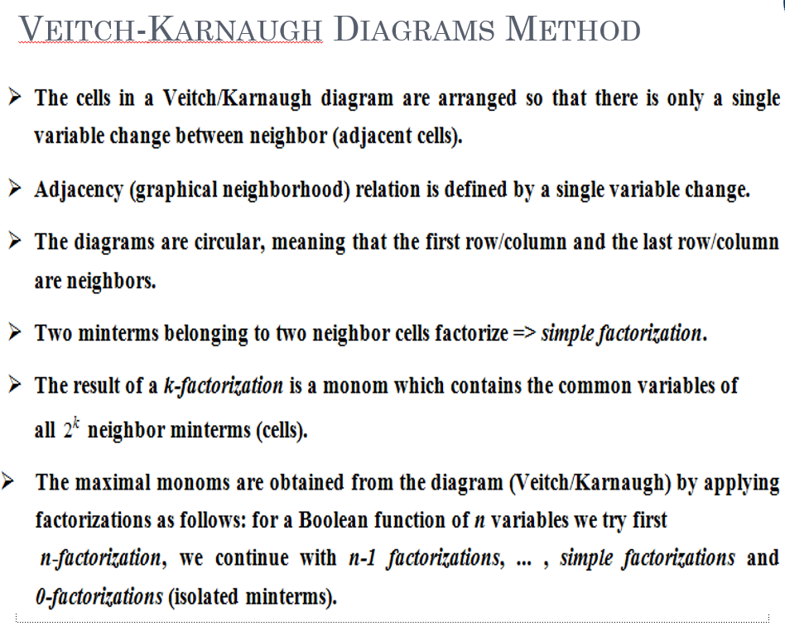
Theoretical results

Slide 6
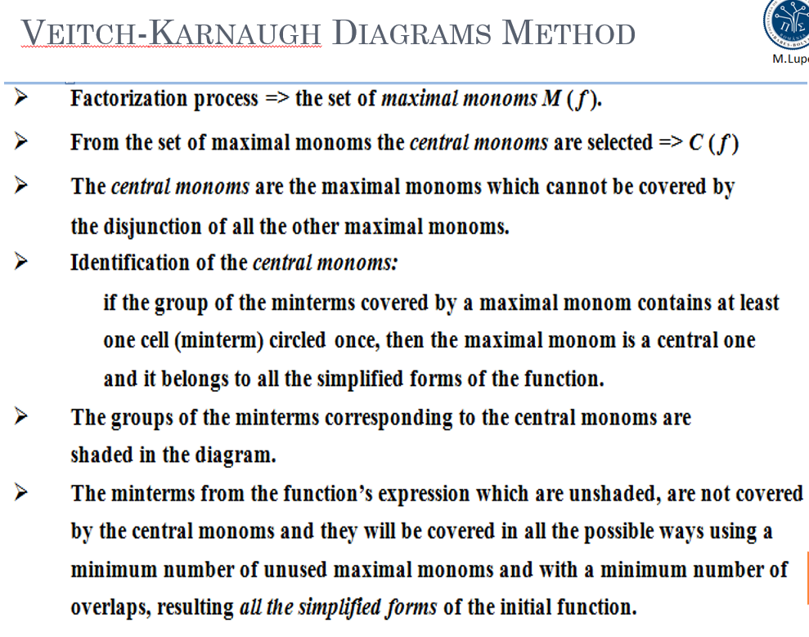
Theoretical results

Slide 7
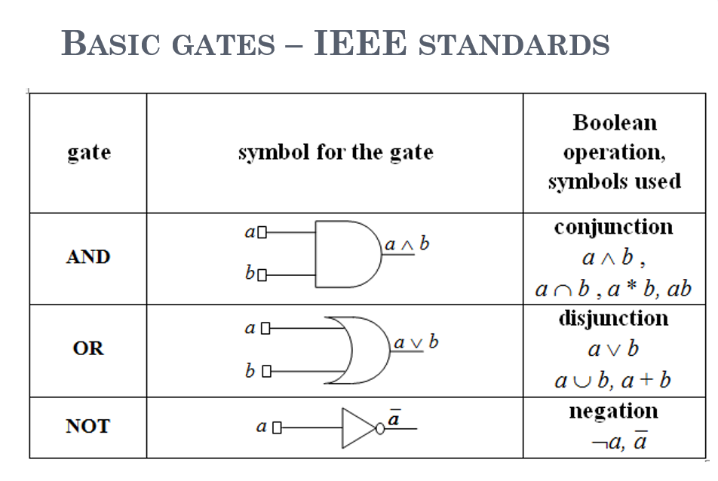
Theoretical results

Slide 8
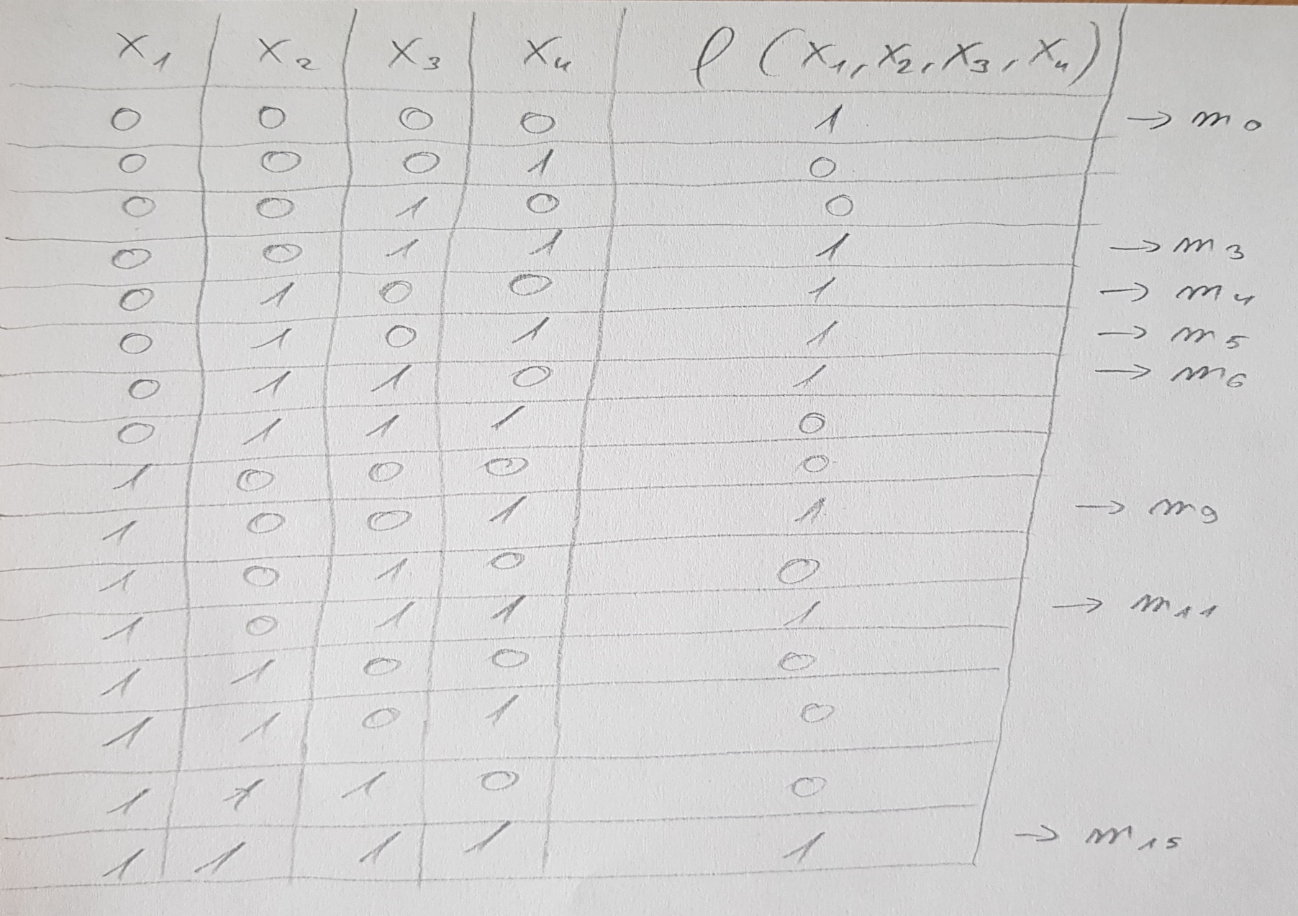
Solution

Slide 9
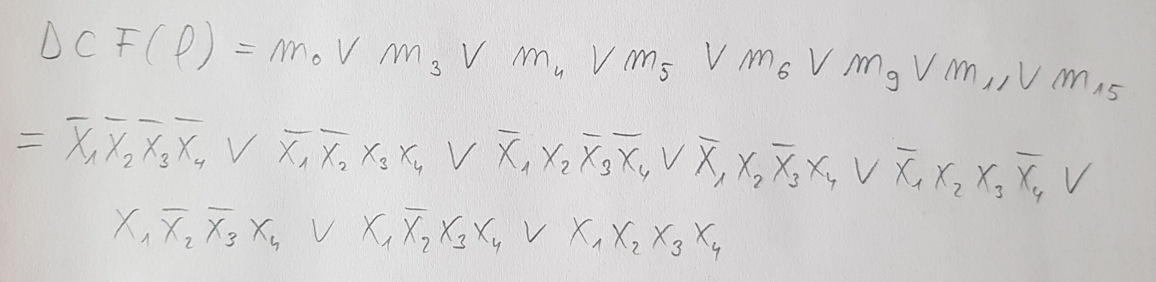
Solution
We build the DCF, using the minterms:

Slide 10
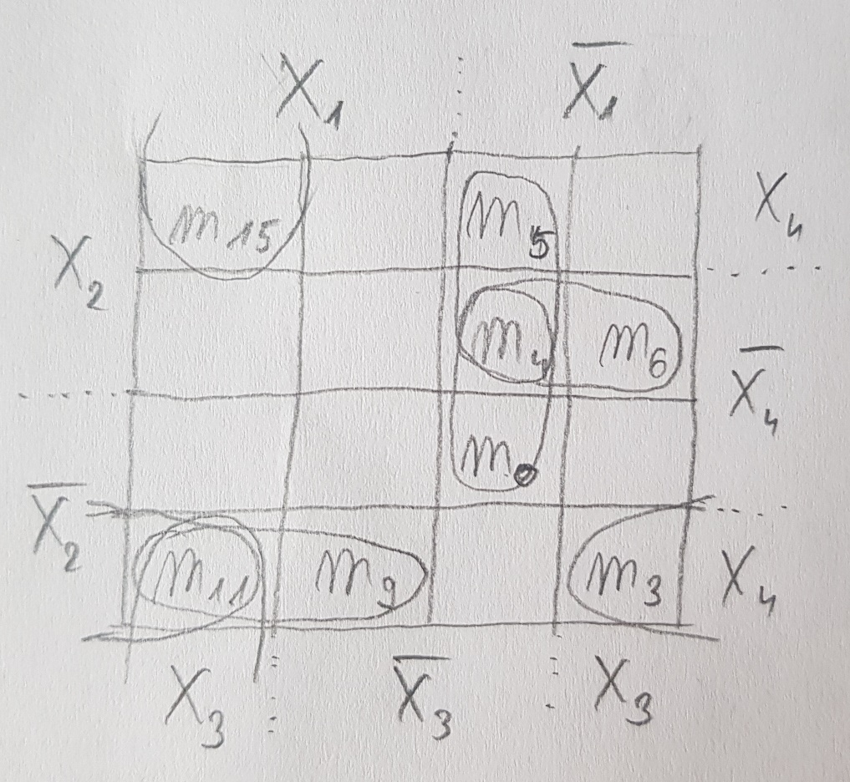
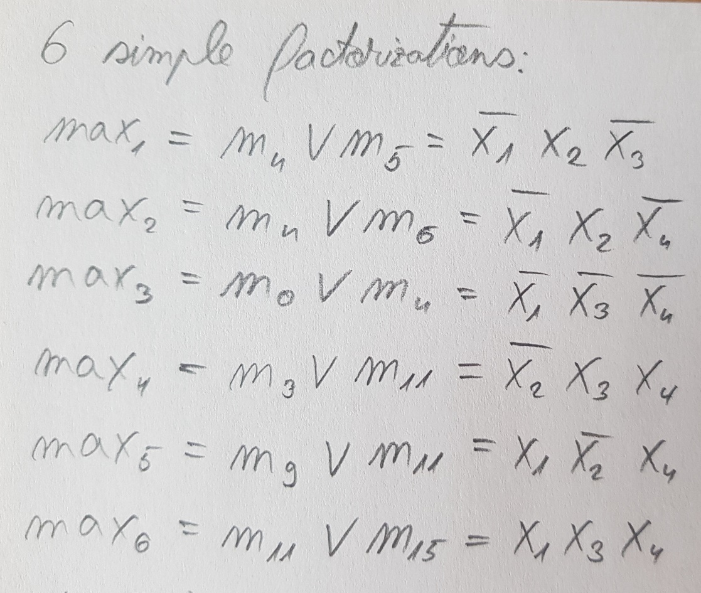
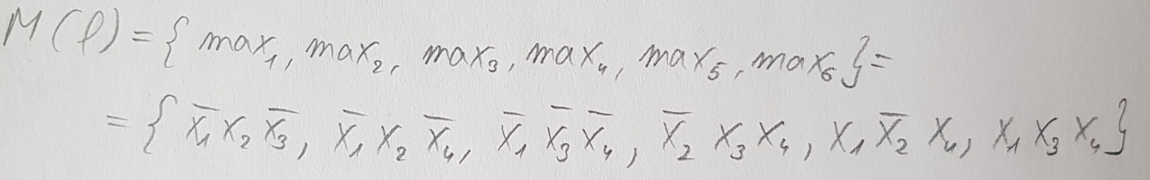
Solution
Simplify using Veitch diagram method:

Slide 11
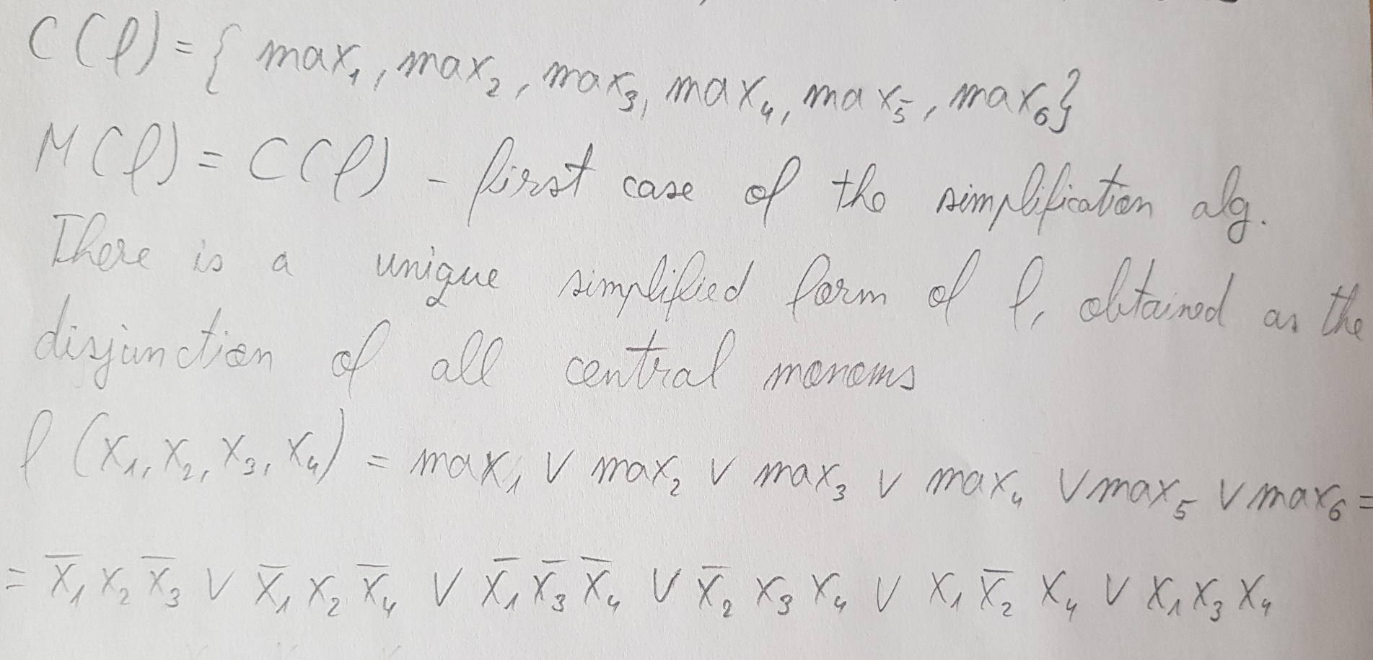
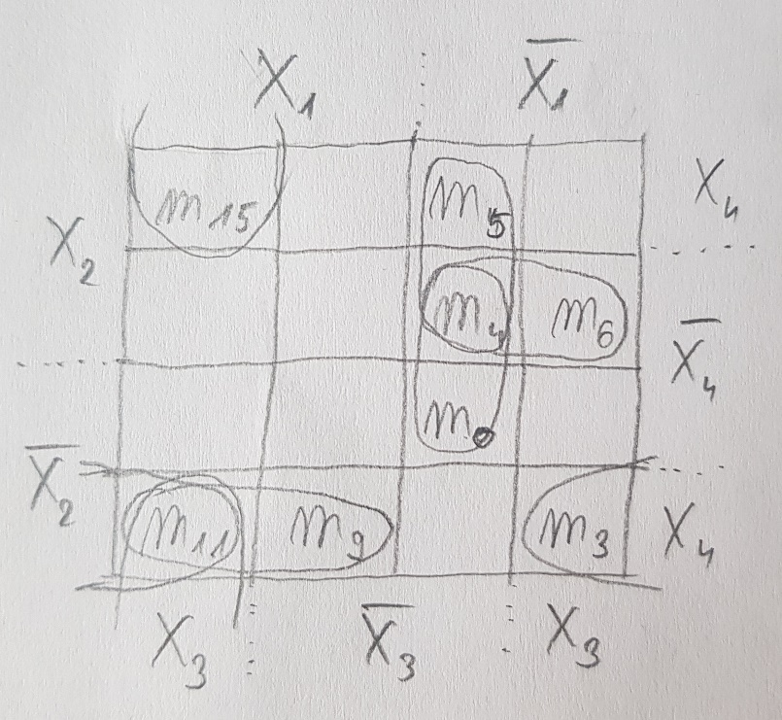
Solution
We build the set of central monoms and get the simplified form of f:
s

Slide 12
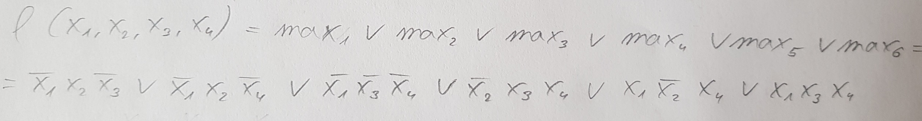
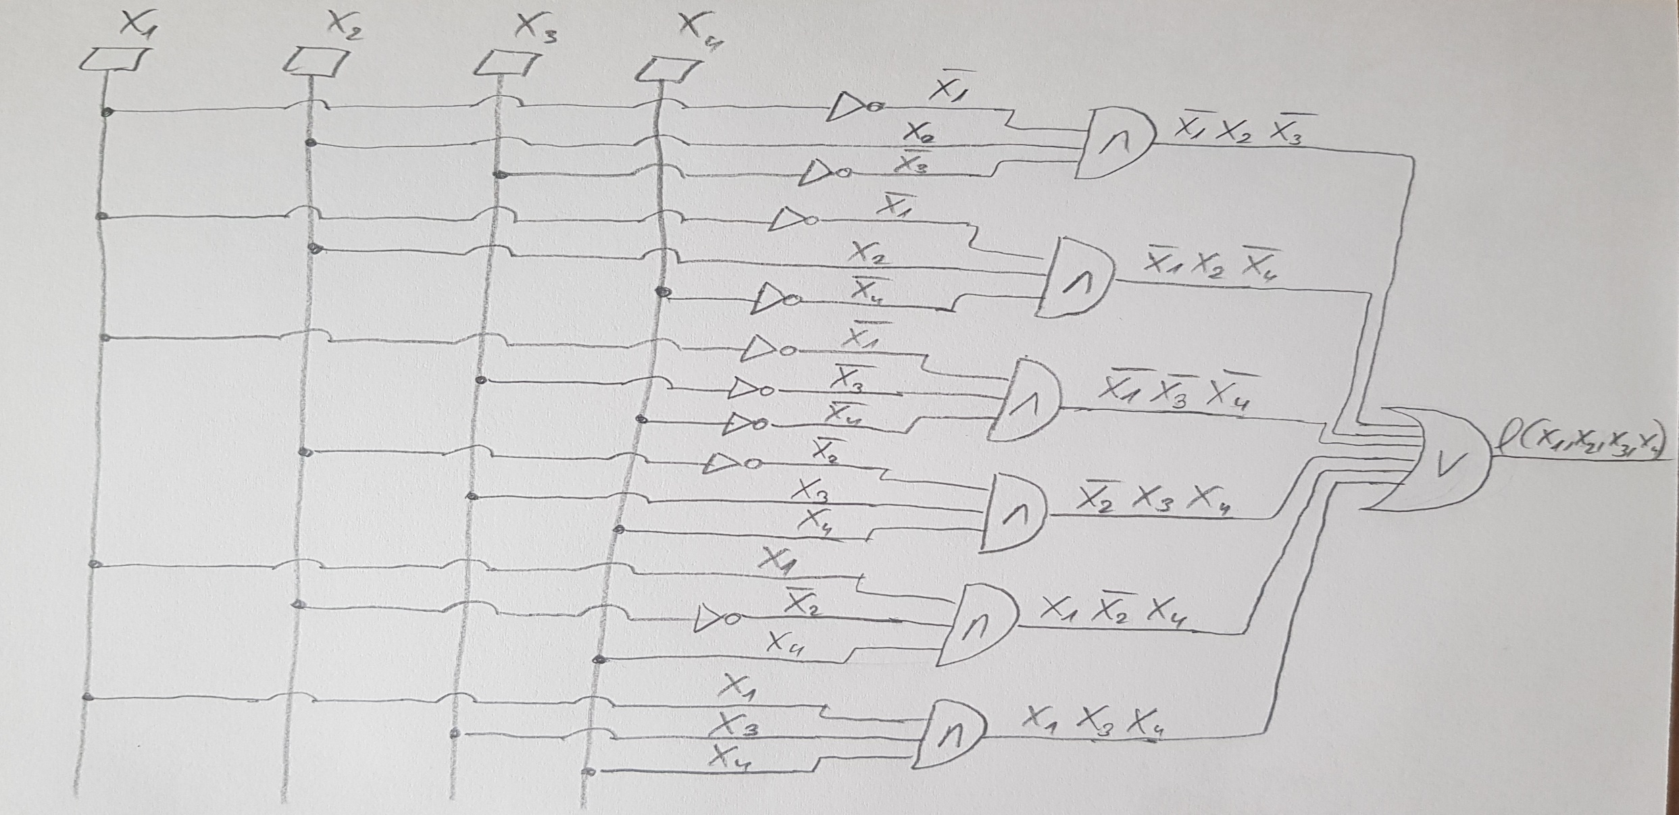
s
s

